Slide 1
British Airways customer buying behaviour Predictions
By
Oluwatosin Adeoye

Slide 2
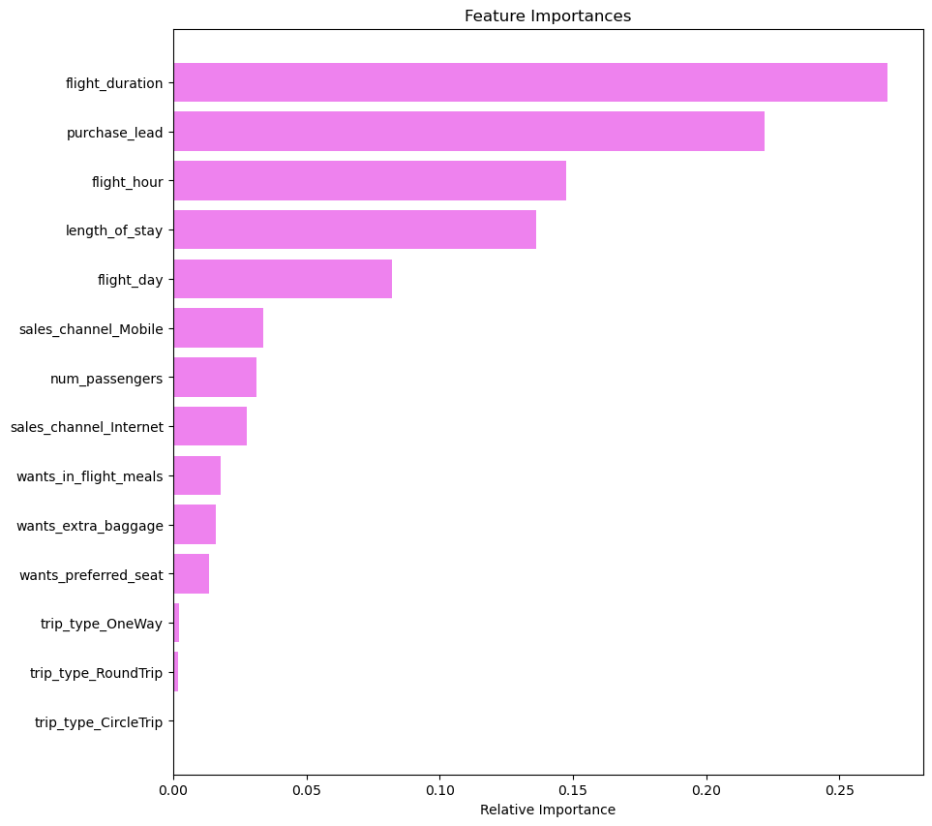
Important Features Contributing to the buying behaviors of Customers
According to the exploratory data analysis (EDA), the majority of customers are from Australia. However, customers from Malaysia have the highest number of completed bookings.
Flight duration, purchase lead time, flight hour, length of stay, and flight day contribute significantly to customers' purchasing behavior.

